Slide 1
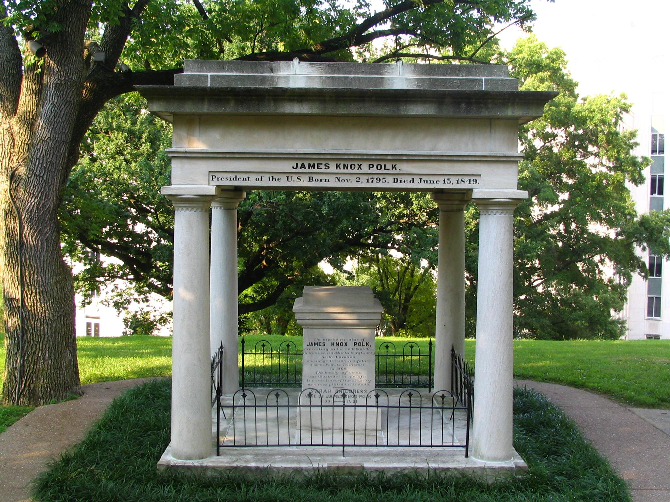
The Burial spot of ex president James K. Polk of Westward Expansion fame.
Note how in 1880 and before only 12% of the population made it to 65 or older, but with the election of Warren G. Harding it jumped to 60%!
Visit the Historic Nashville City Cemetery and Arboretum
Home of History and Beauty
1001 4th Ave S, Nashville, TN 37203

Slide 2
In 1864 and 1865 America was in the midst of the Civil War. Nashville was a hotly contested area as the state has the most rivers and thus transport power of the time. The battle of Nashville was fought in December of 1864, so burials in the area would have continued into the following year. Given the revolutionary advancements in ammunition and the development of more accurate firearms, the American Civil War was the bloodiest war fought until the 20th century in addition to being on American soil. Compare that to the least amounts of burials in the 70s, when the cemetery was already considered "historic" thus slowing down burials there and the wars being fought abroad as opposed to in the state.

